Slide 1
Collection of gender equality policy documents and grey literature in 10 EU member states
Project presentation
Place, date

Slide 2
Aim:
Increase the DATA COLLECTION Catalogue of the EIGE’s e-library in the Resource and Documentation Centre
FOCUS: Gender Equality
Policy Documents
Grey Literature

Slide 3
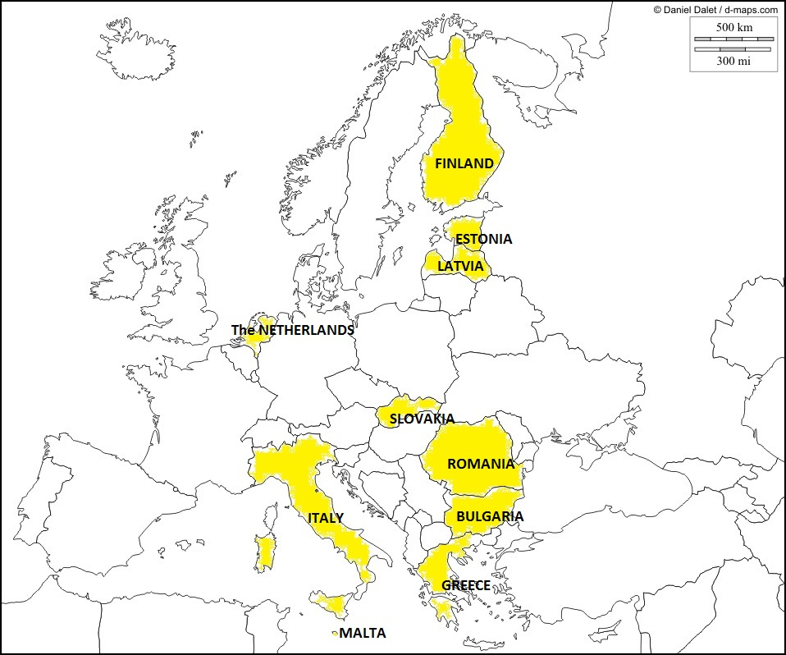
Member States involved in the project

Slide 4
Partner organizations in the 10 UE countries
Latvia
Centre for Gender Studies – University of Latvia
Malta
Fopsim – Foundation for the Promotion of Social Inclusion Malta
The Netherlands
Institute for Gender Studies – Radboud University Nijmegen
Romania
Centrul Filia – Centre for curriculum development and gender studies
Slovakia
Institute for Labour and Family Research
Bulgary
Centre for Women’s Studies and Policies
Estonia
Oü Laas & Laas
Finland
Ekvalita Ab
Greece
CMT Prooptiki
Italy
Studio Come srl

Slide 5
Involvement of the main national stakeholders on gender equality
Promote the knowlegde of EIGE and its RDC among experts and professionals across the Union
Give value to national expertise in the RDC implementation
Assure that key gender equality documents are identified and included in the catalogue, by virtue of national experts knowledge

Slide 6
National stakeholders contacted and involved
Bodies in charge of gender equality
…
…
Social partners
…
…
Other relevant organzations
…
…
…
National Coordinations of NGOs
…

Slide 7
Topics
Gender-based violence
Gender & media
Gender mainstreaming
Gender & Climate change
Work-life balance
Men & Gender equality
Women & the Economy
Women in decision making: political and economic
Gender & sport
Gender & Reseacrh, Technology and Innovation, including women in ICT

Slide 8
Documents type
POLICY DOCUMENTS
Action Plans
Guidelines
Recommendation
Directions
Roadmaps
Bilateral agreements
Any other official document containing directives on gender equality
GREY LITERTURE
Official reports
Parliamentary speeches or reports
Conference proceedings
Surveys
Articles/press releases
Training material
Informative material referring to gender equality policy

Slide 9
SELECTION CRITERIA
Documents should:
Refer to gender equality policy or have a clear policy purpose
Have national relevance
Be useful to define gender equality policy situation and/or development in the country
Refer to the period 1995-2015

Slide 10
DOCUMENTS FORMAT
When both exist, whenever possible
PRINT* & DIGITAL
PRINT*
When only one exists
DIGITAL
*N.B. Printed documents, whenever possible, in 2 COPIES

Slide 11
How to take part and give a contribution
Provide researchers with directions and indications about key documents to understand the development of gender equality policy in the country from 1995 to today
Directly provide documents or give directions about places and ways to collect them
Suggest other possible stakeholders in possession of useful documents
Verify the list of collected documents and, if the case, suggest integrations

Slide 12
Contacts and information
Organization’s name
…
…
…
Studio Come srl
Via Ostiense 30 – 00154 Roma
come@studiocome.it
www.studiocome.it
+39 068541435
Contact person: PATRIZIA DI SANTO
EUROPEAN INSTITUTE FOR GENDER EQUALITY – EIGE
www.eige.europa.eu
RESOURCE AND DOCUMENTATION CENTRE
http://eige.europa.eu/content/rdc

